Slide 1

DATA SCIENCE SALARY ANALYSIS
USING TABLEAU DASHBOARD
ALY6070: Communications and Visualization for Data Analytics
Presented By: Qihuan He, Bhagyashri Ram Kadam,
Yuchen Zhao, Xiaoge Zhang
Date: 03-29-2023
Professor : Venkata Duvvuri

Slide 2

Data Science Job Salaries
Data science is an exciting and rapidly growing field with many opportunities for job seekers. One important factor to consider when exploring job opportunities in data science is the potential salary. However, determining the appropriate salary for a given role can be challenging, as there are many factors that can impact salaries, including location, experience level, and job title.
To help job seekers better understand data science job salaries, a dataset has been compiled on Kaggle that contains information on job postings for data science roles from the year 2020 to 2022.
The dataset includes salary information, job titles, experience level , employment type as well as other relevant details like company location , company size ,remote ratio etc.
By analyzing this dataset, we can gain insights into trends in data science job salaries and better understand the factors that influence salary ranges in this field.

Slide 3
Business Questions
Few Questions we would like answer are :
What kind of Job roles are there in the Data science Industry ?
What is the Salary Distribution Range in the Data Science Industry ?
Which are the Top 10 highest paid Data science Job Titles ? What is their Average salary ?
Company Size : Do big companies offer higher Salary package ?
Employment type : Is there any significant difference in the Average Salary for different Employment types (full time/contract/part time/freelance) ?
Experience Level : Is there any significant difference in the Average Salary for different Employment types (Entry level/Senior level/Mid-level/Executive level) ?
Remote Type : Is there any significant difference in the Average Salary if the Job is Fully Remote/Hybrid/No remote ?
Has the overall Data Science Salary increased/decreased from the year 2020 to 2022 ?

Slide 4
Data Used In
the Analysis
Geographical Role Selected:
Latitude
Longitude
Categorical Variable:
Company Size
Employee Residence
Employment Type
Experience Level
Job Title
Remote Ratio
Numerical:
Salary in USD
Work Year

Slide 5
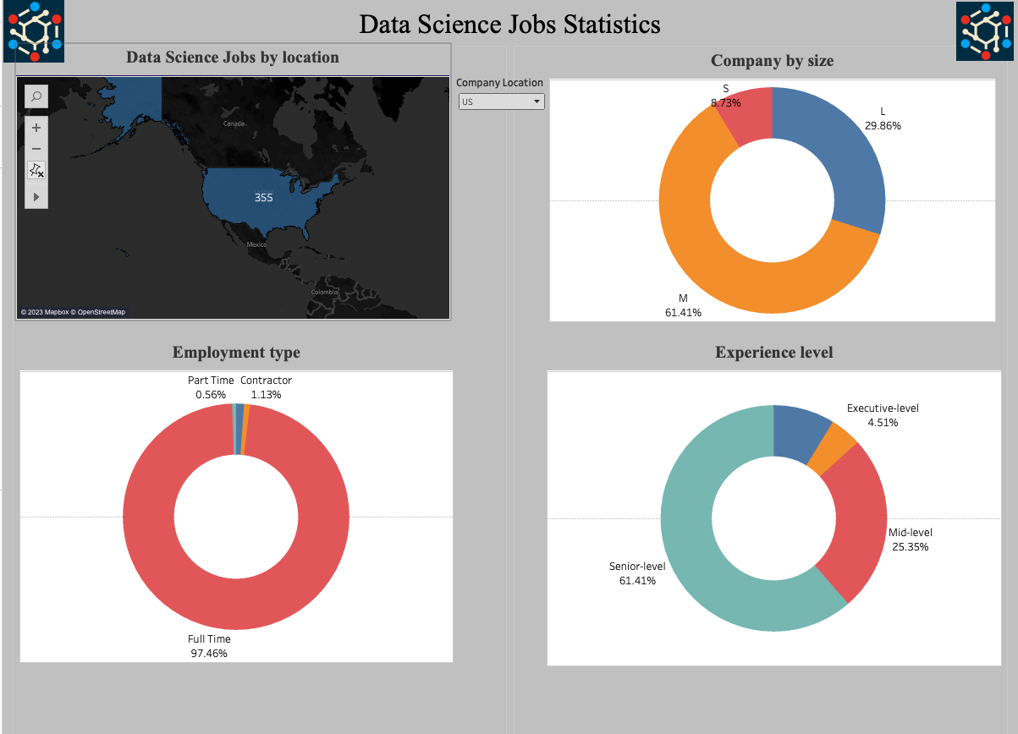

Slide 6
Inferences - Dashboard 1 (Data Science Job Statistics)
Below are some inferences from the Analysis :
Highest Number of Data Science jobs are available in US location as compared to Other locations like NZ , India , Russia etc.
With respect to Data Science Jobs Statistics , for experience level (US location) , there are more Senior Level employees of about 61% as compared to Entry Level , Mid-level & Executive level
For US location , for company size , Mid size form around 61% , large size companies are around 30% and Small size companies are around 8.7%
For Employment Type - US location , there are around 97.46% of folks in Full Time jobs which are the highest as compared to part time /contractor/freelance.

Slide 7
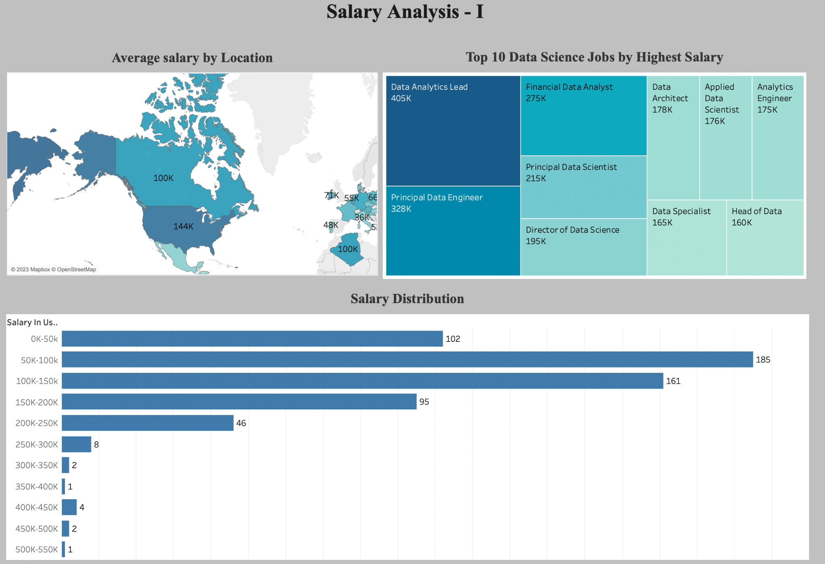
dashbord2

Slide 8
Inferences - Dashboard 2 (Salary Analysis - I)
Below are some inferences from the Analysis :
Russia has the highest average salary of $158k
United States has the second average salary of $144k
Data analytics lead, principle data engineer and financial data analyst are among the highest-paid positions in the industry.
Central tendency of the salary distribution lies within the 50k-100k salary range.

Slide 9
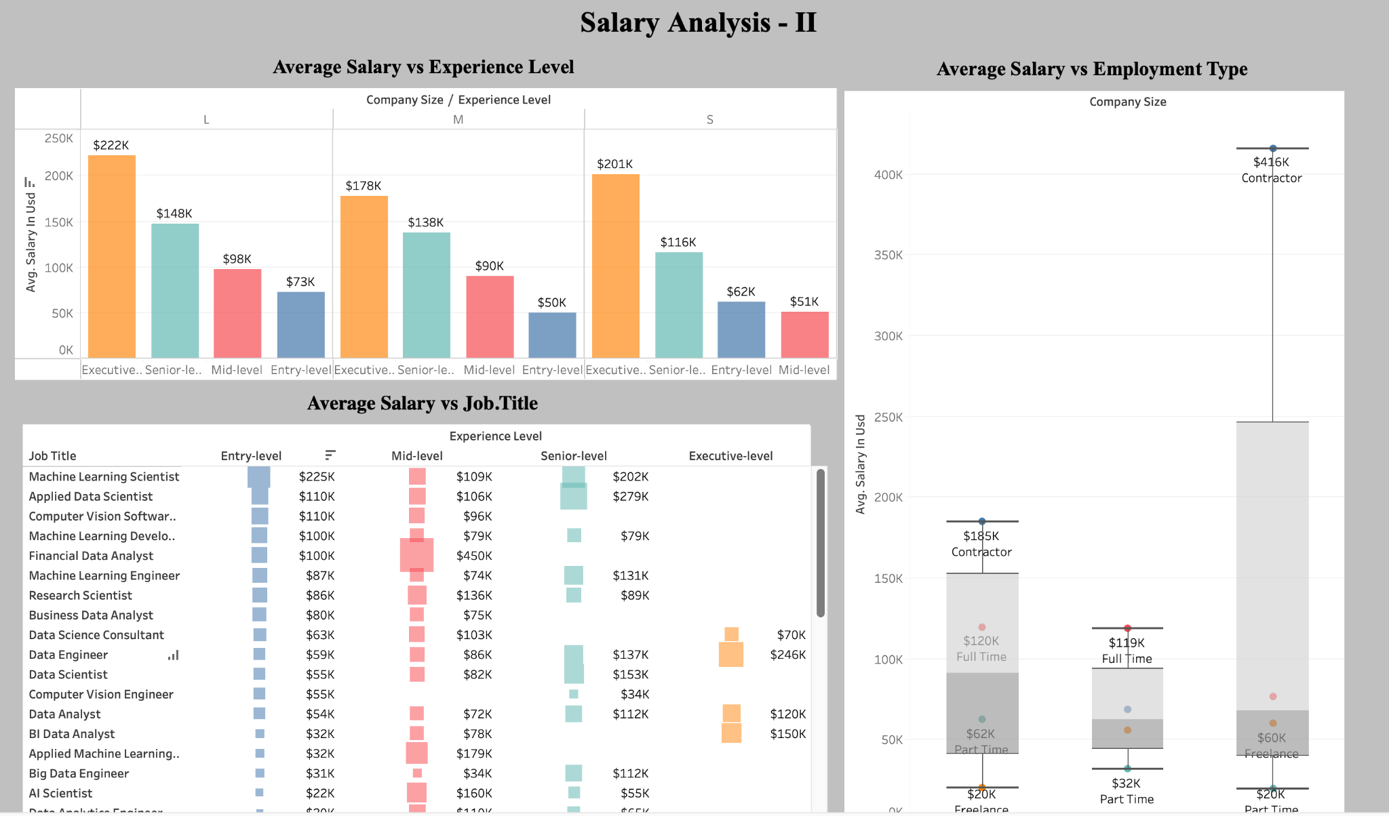
dashbord3

Slide 10
Inferences - Dashboard 3 (Salary Analysis - II)
Below are some inferences from the Analysis :
In general, the average salary increases with experience levels across all company sizes. ( For example, an entry-level at a small company might earn an average salary of $62k, while the same role at a large company might earn $73k. ). The trend is consistent across small, medium, and large companies. Large companies tend to offer higher average salaries for all experience levels compared to small and medium-sized companies.
The average salary increases as the experience level increases for each job title. (For example, an Entry-level Data Engineer might earn an average salary of $59K, while a Senior-level Data Engineer might earn an average of $137K.)
For each company size, full-time positions have higher median salaries compared to part-time and Freelance type. （For example, the median salary for a full-time position at a small company might be $76K, while for a part-time position, it might be $20k. ）
However, small companies tend to offer higher average salaries for contract positions compared to medium and large-sized companies. （For instance, the box plot shows that the median salary for a contract position at a small company is $416k, while for a large company, it's only $185k. ）

Slide 11
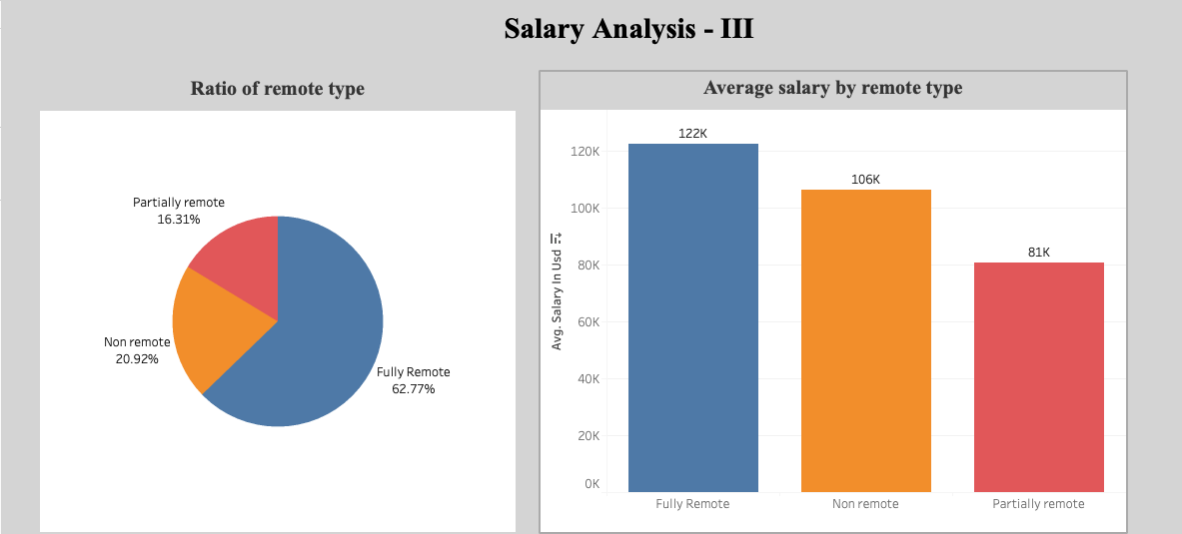
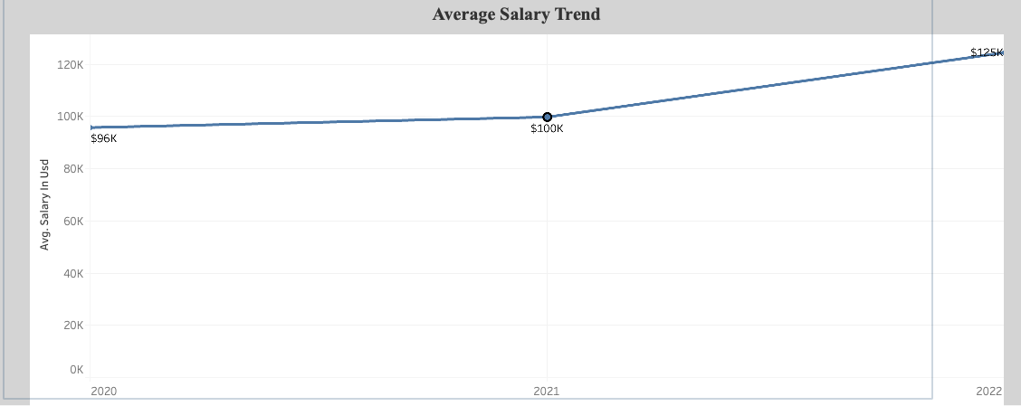

Slide 12
Inferences - Dashboard 4 (Salary Analysis - III)
Below are some inferences from the Analysis :
The job of remote type ratio shows that 62.77% of jobs are fully remote which account for the majority of job types.
The bar chart of salary types shows that the average salary of a fully remote job is 122k which is higher than other job types.
The average salary trend by year indicates that the salary by year had an increasing trend from 2020 to 2022.

Slide 13
Conclusion
It's worth noting that data science salaries have been increasing in recent years, reflecting the high demand for data-related skills.
However, as with any industry, it's important for job seekers to do their research and assess the full range of factors when considering job opportunities.
By carefully considering factors like job title, location, experience level, and company size, job seekers can make informed decisions about pursuing a career in data science.

Slide 14


